Slide 1
Ranking Question-Answers Over Social Media
Manish Kumar Singh
Arjun Malik
Department of Computer Science And Engineering
Under Supervision of:
Prof A. K. Singh

Slide 2
Community Question Answering
Community question-answering is a special type of information exchange system which has been booming in the recent times. It involves asking questions in natural language on social media and then other people who may know the answers to those questions respond to those questions.

Slide 3
Purpose of our project
The purpose of our project was to develop a ranking function for the task of ranking question-answer pairs on the basis of their quality and relevance to a given query. This function takes as input the feature vector of a query-question-answer tuple and then scores the tuple on the basis of the relevance of its question-answer pair to its query, that is the question-answer pair of a tuple with higher score is considered to provide better information regarding the query submitted.

Slide 4
Outline of the project
The complete implementation of this project can be divided into the following phases:
Data extraction from Yahoo! Answers
Processing of the data
Feature extraction
Generating preference data
Finding the ranking function
Testing the so obtained function

Slide 5
Data Extraction from Yahoo! Answers-I
We used factoid questions from two years of the TREC QA track evaluations (years 1999-2000).
A python based application framework, Scrapy was used for crawling Yahoo Answers! and extracting structured data.
Each query obtained from the TREC evaluation track was searched in the Yahoo Answers! search engine and the links of 10-top-rated questions according to the Yahoo Answers! ranking were retrieved.
The list of queries were read and requests were made to crawl the Yahoo Answers! using scapy.Request() API.
The html and xml web pages retrieved were then parsed to find relevant question links.

Slide 6
Data Extraction from Yahoo! Answers-II
Each link obtained was further explored to retrieve a set of relevant answers and features to that question found.
Requests were made for each question link using scrapy.Requests().
The retrieved answer webpage was parsed to extract the answer and related features available on the same webpage.

Slide 7
Processing of the data-I
The data obtained from Yahoo! Answers was in a very raw form and had to be extensively processed to generate features.
First all the new lines and punctuation was stripped off from the data.
Then only those queries and questions were retained in the data which had valid answers with upvotes and downvotes associated with them.

Slide 8
Processing of the data-II
To extract all the features from the data, first feature vectors of all the possible query-question-answer tuples were extracted from the data and they were stored along with the index of their query.
Next the all the feature vectors of the same query were segregated.

Slide 9
Feature extraction
Following features were extracted for each tuple:
Similar number of words in the tuples
Length of query
Length of question
Length of answer
Answer Lifetime
Popularity of the question,
Upvotes of the answer were used
Downvotes of the answer were used

Slide 10
Preference Data
The feature vectors of the same query were compared on the basis of their p/(p+m+s) values to determine their preference as decided by the users of the community, where p=no. of upvotes and m=no. Of downvotes and s is a constant.
After comparing the preference of pairs of feature vectors, we generated a list of pairs of feature vectors in which the first element was considered to be preferable as compared to the second element by the community. This list is called S.

Slide 11
Finding the ranking function
Now we needed to find the ranking function. This task was accomplished as follows:
First we chose an initial guess for the ranking function, in our case we took it to be the sum of all the features of the tuple.
Next we fragmented the entire set S into two subsets: S+, S-. Those pairs in list S in which the first member of the pair scored better on the initial guess were considered to belong to S+, remaining were considered to belong to list S-.

Slide 12
Using the gradient boosting regressor-I
The pairs in the set S- are those in which the first member scores poorly as compared to the second element although the first element is the preferred choice as compared to the second element.
To correctly score the elements of the pairs in S-, we formulated an auxiliary function, g(x) which was obtained by training a gradient boosting regressor taking the first member of the pairs in S as the input training data and the values associated by the initial guess to the second member + some margin, tau as the target data and vice versa for the second member. In case of second member the constant tau was subtracted from the target data.

Slide 13
Using the gradient boosting regressor-II
The initial guess was weighted with the so obtained function, g(x) to obtain a new function, h1(x).
This procedure was recursively applied to obtain subsequent improvements in the ranking function.
The constants involved in this procedure are the margin tau and the weight of the gradient boosting regressor to the ranking function(shrinkage factor). These were varied and the effects on the quality of the ranking function were observed.

Slide 14
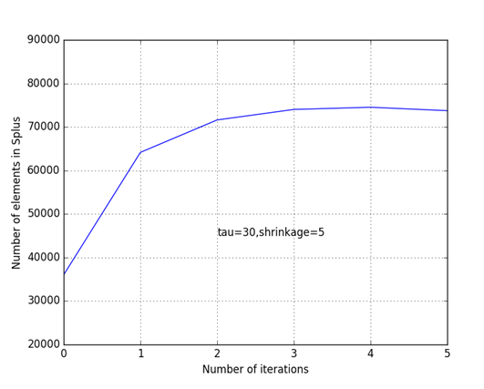
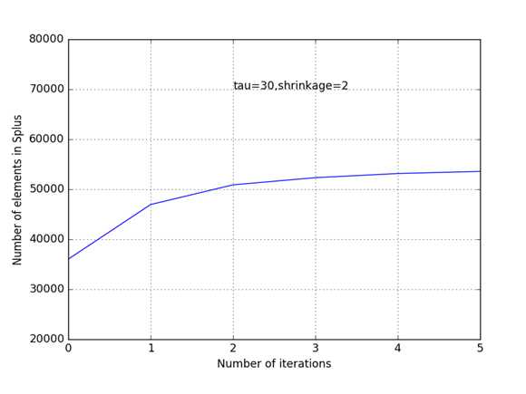
Results
The results obtained are as follows:
Size of the list S+ increases with increase in shrinkage factor.

Slide 15
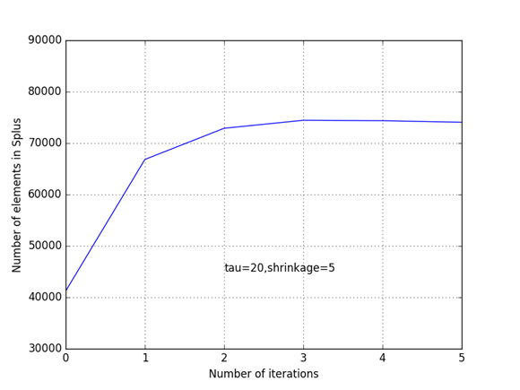
Results
The factor tau introduces an element of large margin classification in the function h(x).
Increasing tau improves the quality of the function upto a certain limit.
However increasing tau beyond a limit causes size of S+ to fluctuate and hence tau cannot be increased too much.

